Slide 1
EDA of Loan Default Risk
Lujun Lyu & Brooke Stealey

Slide 2
Section 1 — Business & Problem Understanding

Slide 3
Project Overview
Goal: Identify repayment patterns among clients
Data Sources:
application_data.csv (current application information)
previous_application.csv ( loan history)
columns_description.xlsx (data dictionary)
Focus:
Applicant demographics
Asset ownership & housing
Loan amount & income distributions
Credit bureau request behavior
Previous application history
Default rate

Slide 4
Section 2 — Data Understanding

Slide 5
Section 2 - Shape
First Steps:
Loaded the three datasets into the notebook
Confirmed their number of rows and columns
Checked variable types (numerical vs categorical)
Looked at functions .head(), .info(), and .describe() to see the shape/any patterns

Slide 6
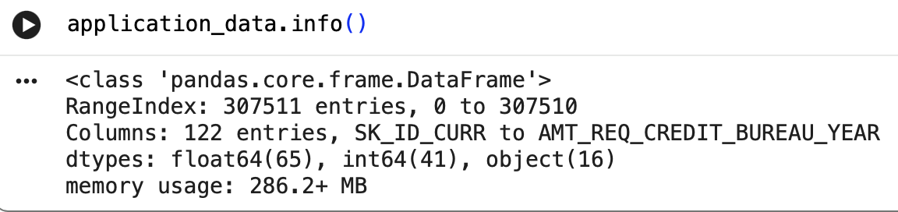
Section 2 - application_data.info()
What this text shows:
The application data set contains 307,511 rows and 122 columns
Includes a mix of numerical (float/int) and categorical (object) variables
Several columns have missing values (see next slide)

Slide 7
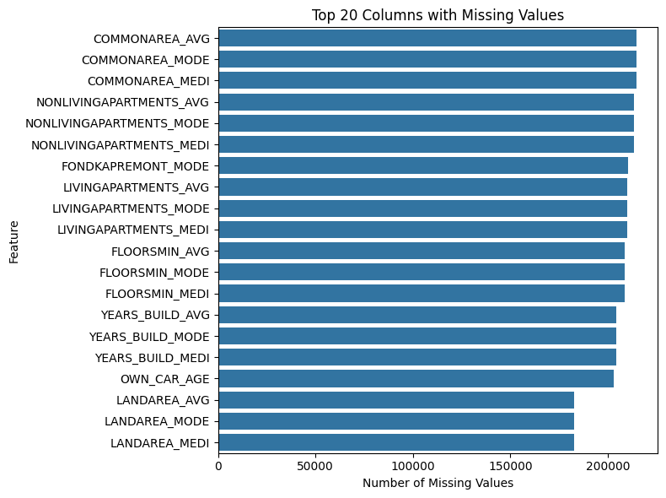
Section 2 - Missing Values
Missing values were identified using summary functions to find which of the top 20 columns had the largest gaps
Results:
  Some features have extensive missing data
  Most missing columns are tied to housing/apartment data

Slide 8
Section 2 - Preparation Before Analysis
Steps Completed:
Abbreviated the data set names for simpler codes
Verified that SK_ID_CURR can be used to merge current/past records
Identified financial variables with strong skew
Reviewed data structure
These steps make sure the dataset is structured properly before moving into the main EDA

Slide 9
Section 3 — Univariate Analysis

Slide 10
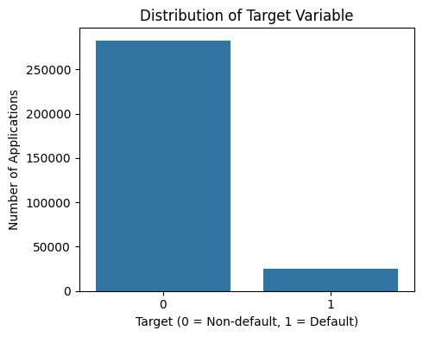
Section 3: Target Variable & Class Imbalance
The target variable indicates whether an applicant experienced payment difficulties.
About 8% of applicants defaulted, while 92% repaid on time.
This strong class imbalance is typical in credit risk data and provides important context for later analysis.

Slide 11
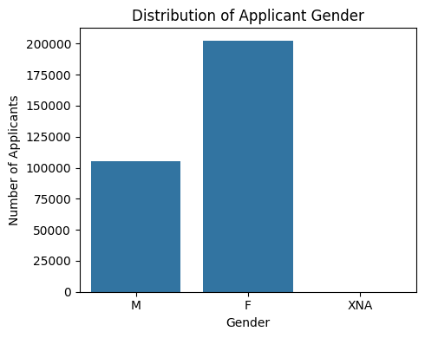
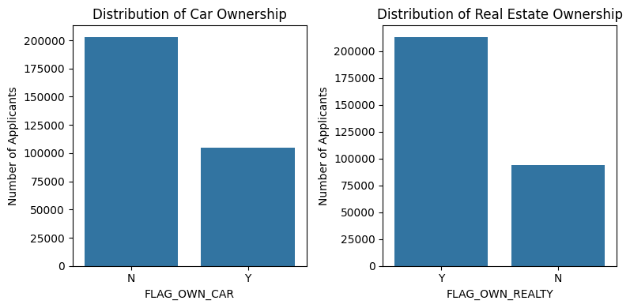
Section 3: Applicant Profile Demographics & Assets
Applicant population is gender-skewed, with more female applicants
Most applicants report no children, indicating smaller households
Asset ownership varies, reflecting heterogeneity in financial stability

Slide 12
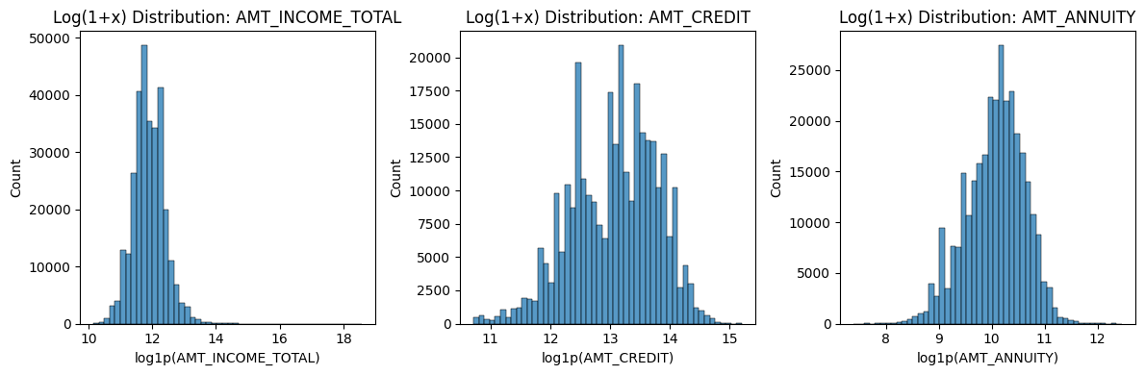
Section 3: Financial Characteristics & Distribution Skew
• Income, credit amount, and annuity exhibit strong right skew.
• Log transformation reveals clearer distributional structure.
• This scaling enables more meaningful comparison in later analysis.

Slide 13
Section 4 — Bivariate Analysis

Slide 14
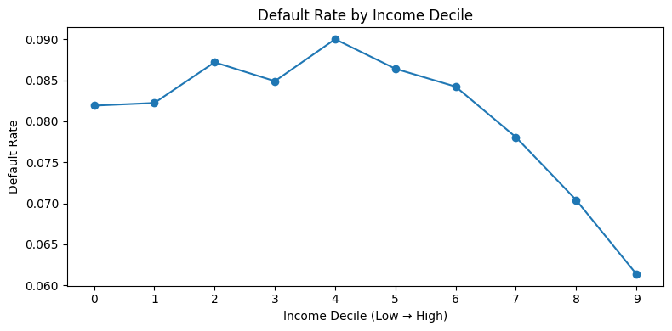
Section 4: Default Risk by Income Level
Default rates are higher among lower-income applicants.
Default probability generally decreases as income increases.
However, income alone does not fully explain default behavior.

Slide 15
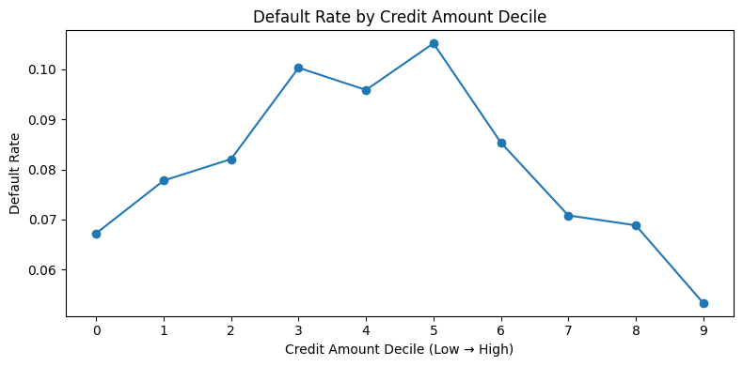
Section 4: Default Risk by Loan Size (Credit Amount)
Default risk varies non-linearly across loan size categories.
Mid-sized loans display relatively higher default rates.
Loan size alone is not a sufficient indicator of default risk.

Slide 16
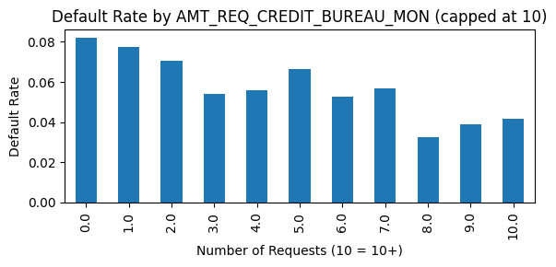
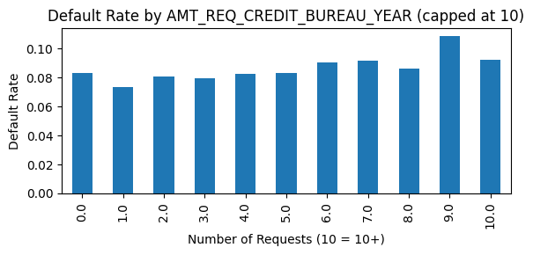
Section 4: Default Risk by Categorical & Behavioral Features
Default rates differ across basic applicant characteristics, such as gender and asset ownership.
Applicants without a car or real estate tend to exhibit higher default rates.
Credit bureau request behavior shows variation in default risk, suggesting recent credit activity may contain risk signals.

Slide 17
Section 5 — Segment and Interaction Analysis

Slide 18
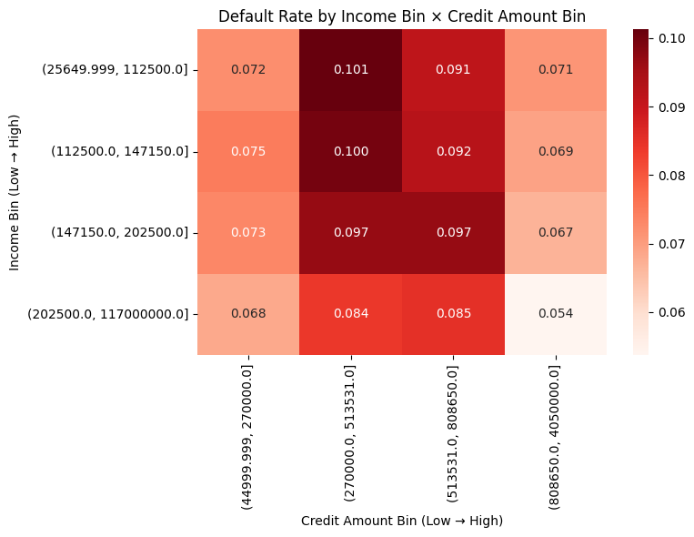
Section 5: Interaction Analysis: Income × Credit Amount
Default risk varies substantially across income–loan size combinations.
Low-income applicants with mid-to-high credit amounts exhibit the highest default rates.
High-income segments maintain relatively low default risk even at higher loan levels.

Slide 19
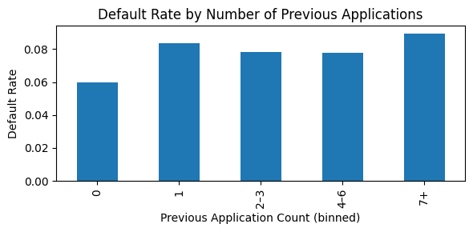
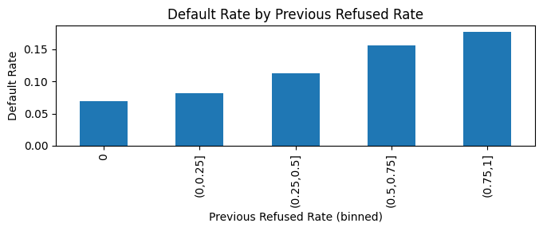
Section 5: Historical Credit Behavior & Default Risk
Default risk increases with the number of previous loan applications.
Applicants with higher historical refusal rates exhibit substantially higher default risk.
Behavioral history provides strong predictive signal beyond current financial characteristics.

Slide 20
Section 6 — Key Insights & Conclusion

Slide 21
Section 6 - Insights & Conclusion
What we found:
Lower income → higher default rates
Medium-sized loans →highest risk
Income & credit amount reveals high-risk groups
  Highest risk: low-income + medium credit amount
  Lowest risk: high income + high credit amount
Past refusals → strongly linked to higher default
Asset ownership & credit checks show financial stability of applicant
Conclusion:
EDA helps identify the factors most closely related to default risk, ultimately giving banks and lenders a foundation for stronger models and policies. These insights help drive more reliable, data-driven decisions when reviewing applicants.

Slide 22
Thank You!

